Slide 1
Cloud Computing: Storage as a Service
Vijay Dialani, PhD
Boise State University
vijaydialani@boisestate.edu
©All rights reserved by the author

Slide 2
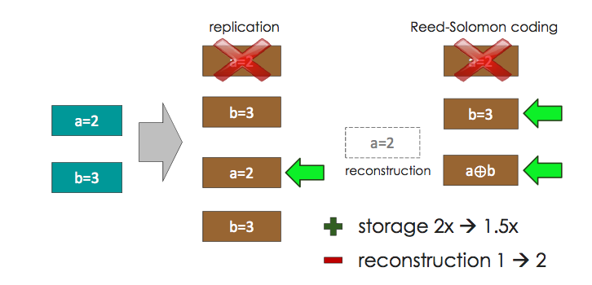
Recap
Parity codes allow for error detection and error correction

Slide 3
Recap
Recovering from multiple failures require exchanges of messages and bounded reconstruction cost is preferred.
r redundancies → correct r erasures
a
b
a+b
a+d
c
d
c+d
c+b+d
a+b
a+d
1st rebuilt block = (c+b+d)-(c+d) = b
2nd rebuilt block = (a+b)-b = a
3rd rebuilt block = (a+d) – a = d
4th rebuilt block = (c+d)-d =c
c+d
c+b+d

Slide 4
Recovering from single failures
ZigZag Codes
 | Node-0 | Node-1 | Node-2 | Row sum | ZigZag sum
0 | m | a | w | m+a+w | 2m+c+2z
1 | n | b | x | n+b+x | 2n+d+y
2 | p | c | y | p+c+y | p+a+x
3 | q | d | z | q+d+z | q+b+2w
Access v/s Bandwidth
For M rows
 | Optimal Access | Optimal Bandwidth
Optimal Update | M+1 | M+1
Non-optimal update | 3m<k<2^{2m} (More) | 2M (Less)

Slide 5
Storage
Reed Solomon Codes
Reconstruction Cost
Replication
Storage Overhead

Slide 6
Reed Solomon Codes
For an indepth mathematical treatment follow the articles:
http://tools.ietf.org/html/rfc5510#page-17
http://www.mth.msu.edu/~jhall/classes/codenotes/grs.pdf

Slide 7

Lets look at analogous QR codes
QR codes
Designed to reduce the number of errors in reading of digital barcodes
Contains both data and error correction information
It is possible to detect and recover from error using QR codes
Ability to recover from multiple failures
Notes:
http://en.wikiversity.org/wiki/Reed%E2%80%93Solomon_codes_for_coders

Slide 8
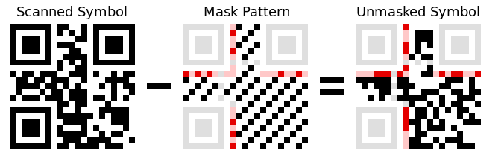
What is underneath the pattern?
There are two identical copies of the format information, so that the symbol can still be decoded even if it is damaged. The second copy is broken in two pieces and placed around the other two locators, and is also read in a counter-clockwise direction (upwards in the lower-left corner, then left-to-right in the upper-right corner).
Input 101101101001011
Mask ^ 101010000010010
Output 000111101011001

Slide 9
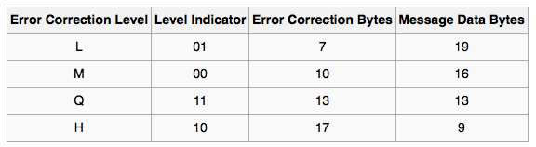
QR symbol
The first two bits of format information give the error correction level used for the message data. A QR symbol this size contains 26 bytes of information. Some of these are used to store the message and some are used for error correction, as shown in the table below. The left-hand column is simply a name given to that level.

Slide 10
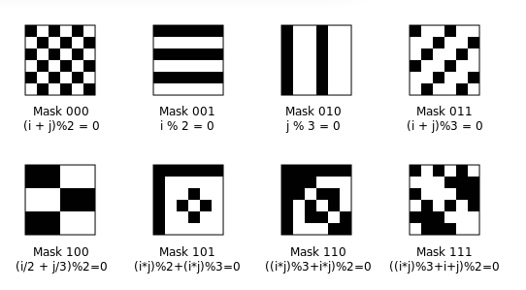
QR Codes
Each mask is well suited for detection of multiple errors for a range of encoded data

Slide 11
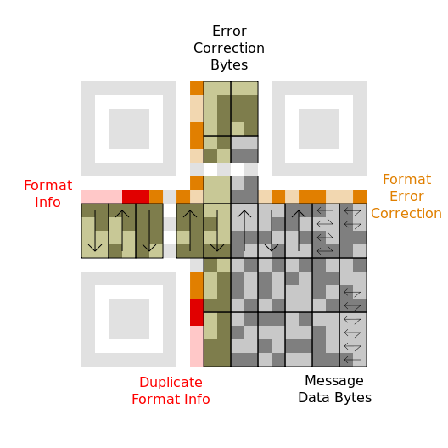
Regions in a QR code
Data bits are read starting from the lower-right corner and moving up the two right-hand columns in a zig-zag pattern.
The first three bytes are 01000000 11010010 01110101. The next two columns are read in a downward direction, so the next byte is 01000111.
Upon reaching the bottom, the two columns after that are read upward. Proceed in this up-and-down fashion all the way to the left side of the symbol
Message data bytes: 40 d2 75 47 76 17 32 06 27 26 96 c6 c6 96 70 ec
Error correction bytes: bc 2a 90 13 6b af ef fd 4b e0

Slide 12
Reed Solomon Codes
d1
d2
d3
d4
d5
d6
d7
d8
d9
d10
d11
d12
c1
c2
c3
Reed Solomon 12 + 3
Failure Recovery requires: 11 data access from data node + 1 parity = 12

Slide 13
Pyramid Codes
d1
d2
d3
d4
d5
d6
d7
d8
d9
d10
d11
d12
c1
c2
c3
C1,1
C1,2
C1,1 : {d1,d2,….,d6}
C1,2 : {d7,d8,….,d12}
Parity construction costs remain the same, so storage performance is unaffected
The recovery access reduces to half (6+1).
Storage overhead is the same (16/12) = 1.33, greater than 15/12 = 1.25 in previous case

Slide 14
Pyramid Code one failure example
d1
d2
d3
d4
d5
d6
C1,1
d7
d8
d9
d10
d11
d12
C1,2
c2
c3
Reconstruction cost for a single failure in each row: 6 messages, compared to 12 in previous non-pyramid case

Slide 15
Pyramid Code two failures example
d1
d2
d3
d4
d5
d6
C1,1
d7
d8
d9
d10
d11
d12
C1,2
c2
c3
Recover d3 and d5 from c2 and c3 or reconstruct c1 to recover from multiple failures
Number of messages: 6

Slide 16
Pyramid Codes multiple hierarchy
d1
d2
d3
C1,1
C2,1
d4
d5
d6
C1,2
d7
d8
d9
C1,3
C2,2
d10
d11
d12
C1,4
c3

Slide 17
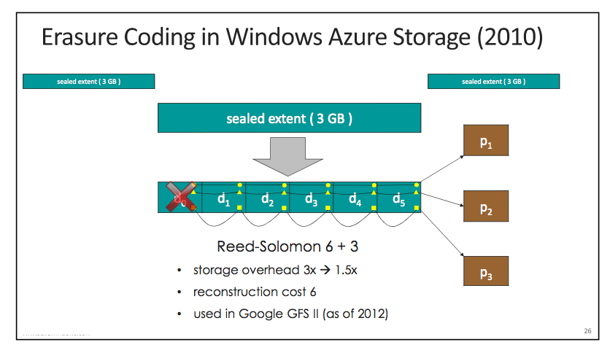
Storage in Azure
Thanks to Cheng Huang, Microsoft Research

Slide 18
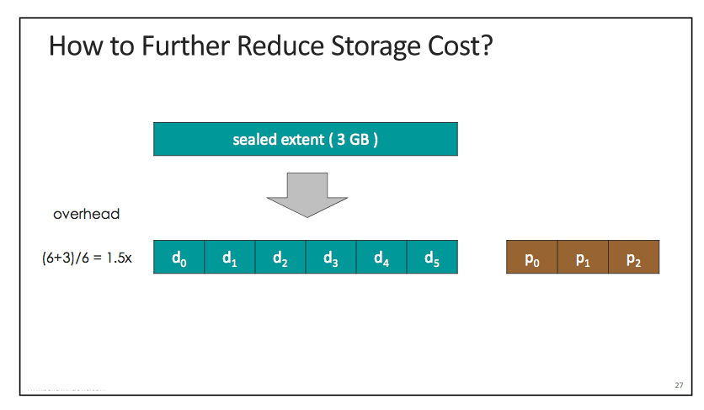
Storage in Azure
Thanks to Cheng Huang, Microsoft Research

Slide 19
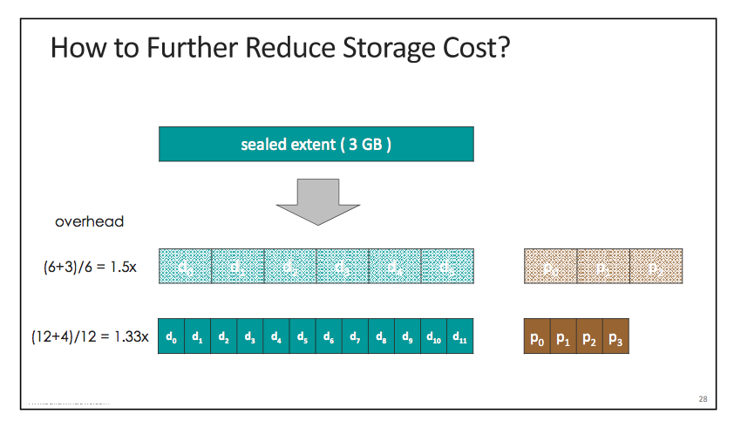
Storage in Azure
Thanks to Cheng Huang, Microsoft Research

Slide 20
Storage in Azure
Thanks to Cheng Huang, Microsoft Research

Slide 21
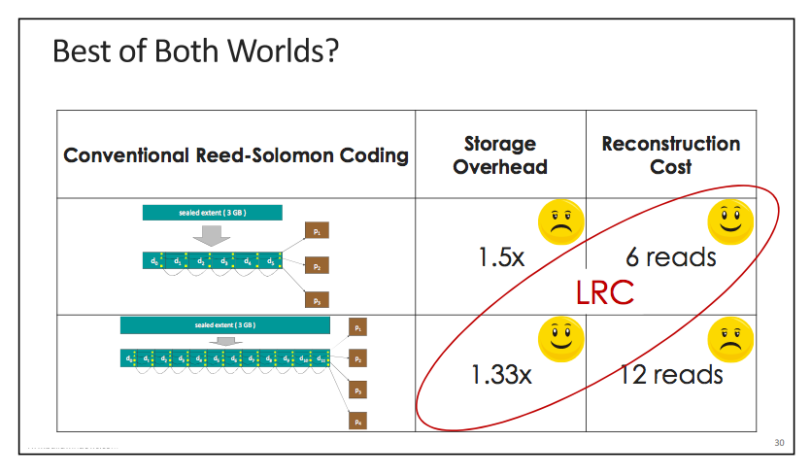
Storage in Azure
Thanks to Cheng Huang, Microsoft Research

Slide 22
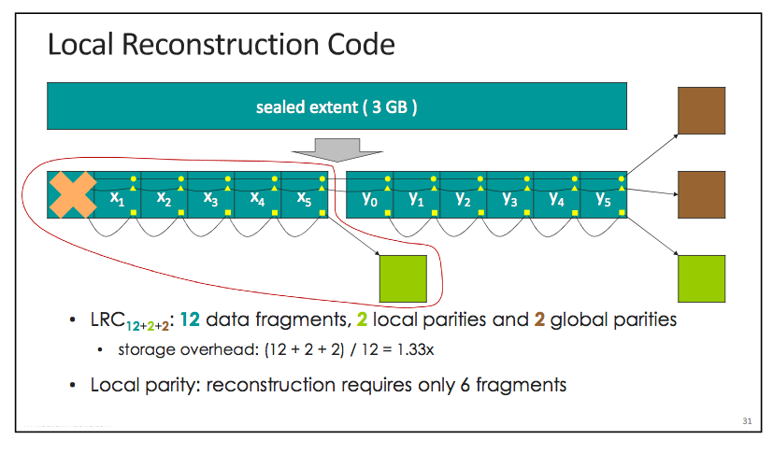
Storage in Azure
Thanks to Cheng Huang, Microsoft Research

Slide 23
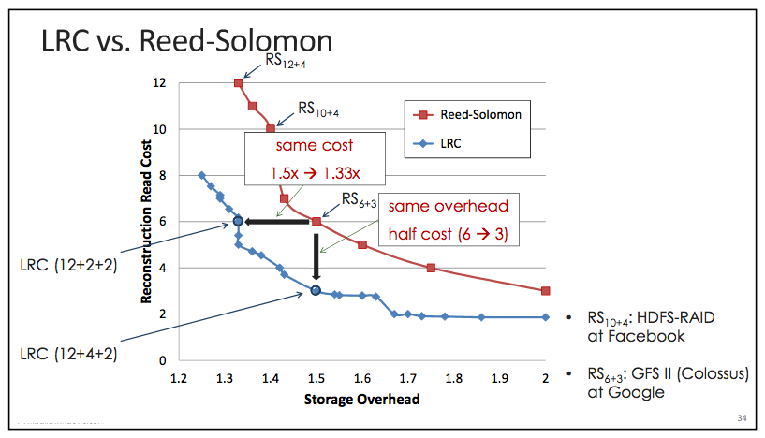
Storage in Azure
Thanks to Cheng Huang, Microsoft Research

Slide 24
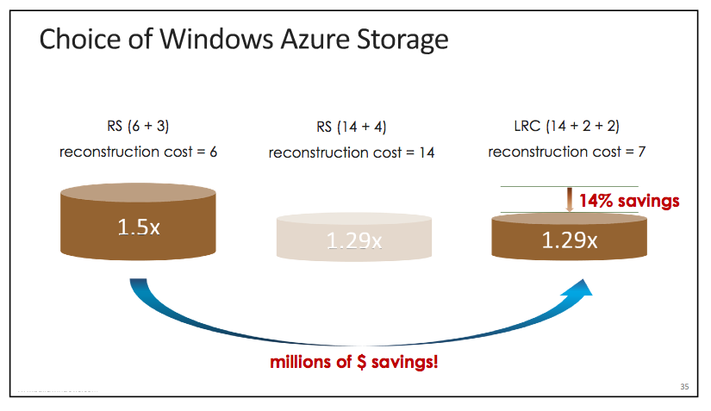
Storage in Azure
Thanks to Cheng Huang, Microsoft Research

Slide 25
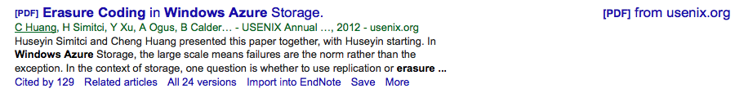
References

